Slide 1
8051 Interfacing

Slide 2
KEYBOARD Interfacing
Keyboards are organized in a matrix of rows and columns
The CPU accesses both rows and columns through ports
Therefore, with two 8-bit ports, an 8 x 8 matrix of keys can be connected to a microprocessor
When a key is pressed, a row and a column make a contact
Otherwise, there is no connection between rows and columns

Slide 3
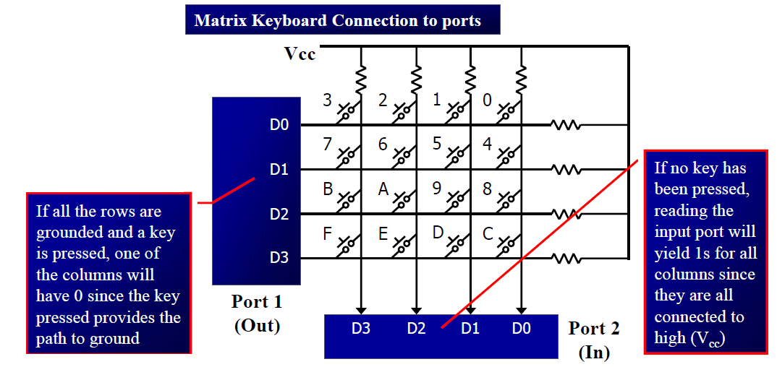
4 x 4 Matrix
A 4x4 matrix connected to two ports
The rows are connected to an output port and the columns are connected to an input port

Slide 4
It is the function of the microcontroller to scan the keyboard continuously to detect and identify the key pressed
To detect a pressed key, the microcontroller grounds all rows by providing 0 to the output latch, then it reads the columns
If the data read from columns is D3 – D0 = 1111, no key has been pressed and the process continues till key press is detected
If one of the column bits has a zero, this means that a key press has occurred
For example, if D3 – D0 = 1101, this means that a key in the D1 column has been pressed
After detecting a key press, microcontroller will go through the process of identifying the key

Slide 5
Starting with the top row, the microcontroller grounds it by providing
a low to row D0 only
It reads the columns, if the data read is all 1s, no key in that row is activated and the process is moved to the next row It grounds the next row, reads the columns, and checks for any zero
This process continues until the row is identified
After identification of the row in which the key has been pressed
Find out which column the pressed key belongs to

Slide 6
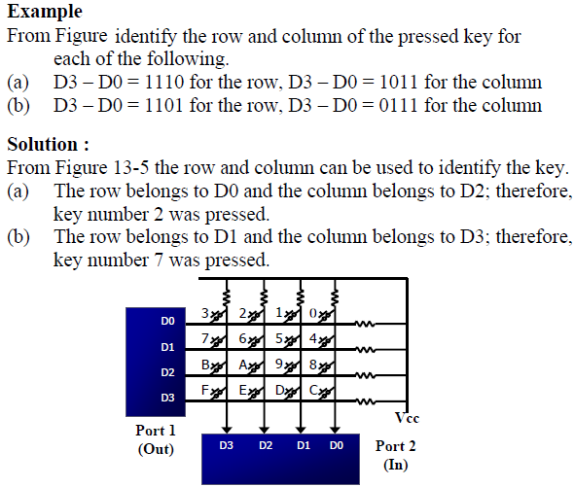
Solution????

Slide 7
Solution:

Slide 8
Program for detection and identification of key activation goes through the following stages:
To make sure that the preceding key has been released, 0s are output to all rows at once,
and the columns are read and checked repeatedly until all the columns are high
When all columns are found to be high, the program waits for a short amount of time before it goes to the next stage of waiting for a key to be pressed
2. To see if any key is pressed, the columns are scanned over and over in an infinite loop
until one of them has a 0 on it
Remember that the output latches connected to rows still have their initial zeros (provided in stage 1), making them grounded
After the key press detection, it waits 20 ms for the bounce and then scans the columns again
it ensures that the first key press detection was not an erroneous one due a spike noise
If after the 20-ms delay the key is still pressed, it goes back into the loop to detect a real key press

Slide 9
Mechanical switches are used as keys in most of the keyboards. When a key is pressed the contact bounce back and forth and settle down only after a small time delay (about 20ms). Even though a key is actuated once, it will appear to have been actuated several times. This problem is called Key Bouncing.
To detect which row key press belongs to, it grounds one row at a time, reading the columns each time
If it finds that all columns are high, this means that the key press cannot belong to that row.
Therefore, it grounds the next row and continues until it finds the row the key press belongs to
Upon finding the row that the key press belongs to, it sets up the starting address for the look-up table holding the scan codes (or ASCII) for that row
To identify the key press, it rotates the column bits, one bit at a time, into the carry flag and checks to see if it is low
Upon finding the zero, it pulls out the ASCII code for that key from the look-up table
Otherwise, it increments the pointer to point to the next element of the look-up table

Slide 10
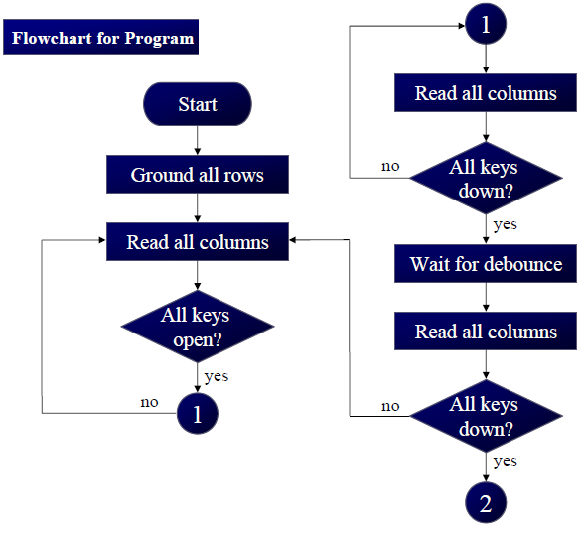
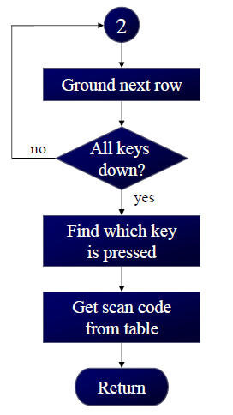
Flow Chart

Slide 11
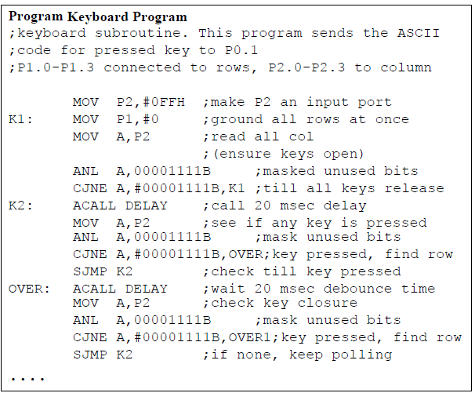

Slide 12
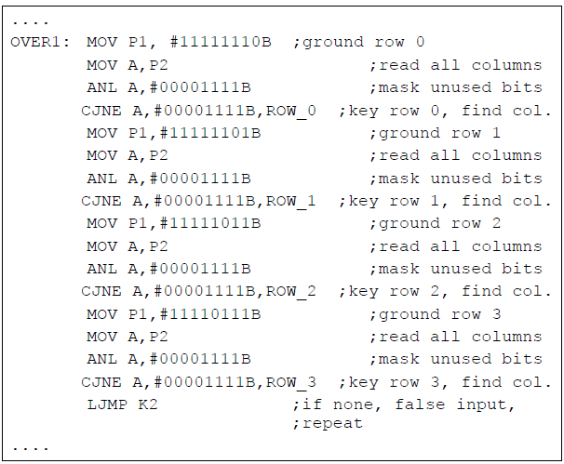

Slide 13
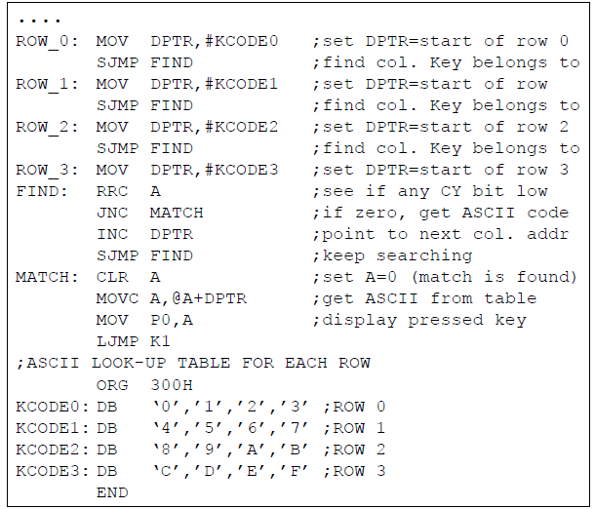

Slide 14
8051 Interfacing DAC
Microcontroller are used in wide variety of applications like for measuring and control of physical quantity like temperature, pressure, speed, distance, etc.
In these systems microcontroller generates output which is in digital form but the controlling system requires analog signal as they don't accept digital data thus making it necessary to use
DAC converts digital data into equivalent analog voltage.
Digital to Analog Converter is a device used to convert digital pulses to analog signals.

Slide 15
To convert the digital signal to analog signal a Digital-to-Analog Converter (DAC) has to be employed.
The DAC will accept a digital (binary) input and convert to analog voltage or current.
Every DAC will have "n" input lines and an analog output.
The DAC require a reference analog voltage (V_{ref}) or current (I_{ref}) source.
The smallest possible analog value that can be represented by the n-bit binary code is called resolution.
The resolution of DAC with n-bit binary input is 1/2^{n} of reference analog value.
Every analog output will be a multiple of the resolution.

Slide 16
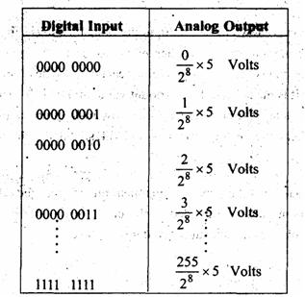
For example, consider an 8-bit DAC with reference analog voltage of 5 volts. The analog
values for all possible digital input are as shown.

Slide 17
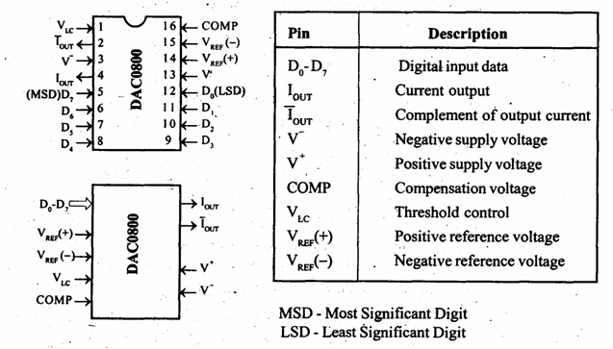
PIN DIGRAM OF DAC0800

Slide 18
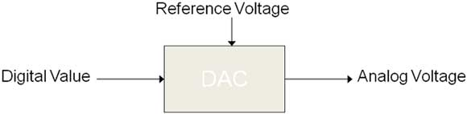

Slide 19
The DAC 0800 is an 8-bit, high speed, current output DAC with a typical settling time (conversion time) of 100 ns.
It produces complementary current output, which can be converted to voltage by using simple resistor load.
The DAC0800 require a positive and a negative supply voltage in the range of ± 5V to ±18V.
The reference voltage and the digital input will decide the analog output current, which can be converted to a voltage by simply connecting a resistor to output terminal or by using an op-amp I to V converter.
The DAC0800 is available as a 16-pin IC in DIP.

Slide 20
Square Wave Generation
ORG 0000h
MOV P1,# 00 H
LOOP 1 MOV P1, # FF H ; Port 1 is connected to input pins of DAC
ACALL, DELAY
MOV P1,# 00 H
ACALL DELAY
SJMP LOOP 1
DELAY: mov r0,#10
del2: mov r1,#250
del1: mov r2,#250
djnz r2,$
djnz r1,del1
djnz r0,del2
ret
END

Slide 21
Triangular Wave Generation
ORG 0000h
MOV R7,#00H
triwave1: MOV P1,R7 ; Port 1 is connected to input pins of DAC
INC R7
CJNE R7, #FFH, triwave1
MOV R7,#FFH
triwave2: MOV P1,R7
DJNZ R7,triwave2
SJMP, triwave1
END

Slide 22
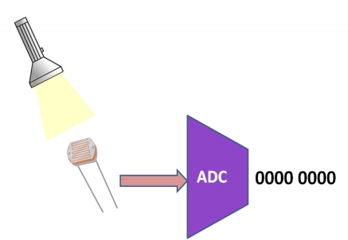
8051 Interfacing ADC
•
Digital computers use binary values but in physical world everything is Analog
(continuous) eg. Temperature,
Pressure
•
A physical quantity is converted into electrical (voltage, current) signals using a device called as Transducer (also referred as
Sensors).
•
We need Analog-to-Digital
converter (ADC) to translate Analog signals to Digital number so that Microcontroller can read and process them.
ADC0808 allows us to monitor upto 8 different analog input channels using single chip
•

Slide 23
ADC is the Analog to Digital converter, which converts analog data into digital format; usually it is used to convert analog voltage into digital format.
Analog signal has infinite no of values like a sine wave or our speech, ADC converts them into particular levels or states, which can be measured in numbers as a physical quantity.
Instead of continuous conversion, ADC converts data periodically, which is usually known as sampling rate.
Telephone modem is one of the examples of ADC, which is used for internet, it converts analog data into digital data, so that computer can understand, because computer can only understand Digital data.
The major advantage, of using ADC is that, noise can be efficiently eliminated from the original signal and digital signal can travel more efficiently than analog one. That’s the reason that digital audio is very clear, while listening.

Slide 24
ADC0808 is a monolithic CMOS device and microprocessor compatible control logic and has 28 pin which gives 8-bit value in output and 8- channel ADC input pins (IN0-IN7).
Its resolution is 8 so it can encode the analog data into one of the 256 levels (2⁸).
This device has three channel address line namely: ADDA, ADDB and ADDC for selecting channel.

Slide 25
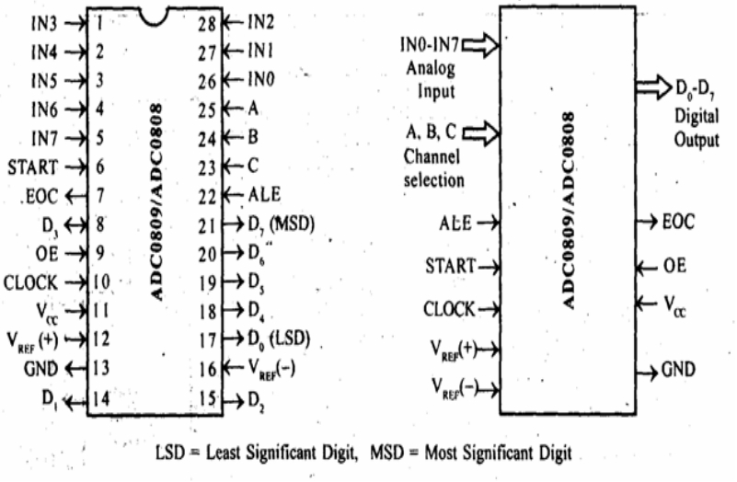
PIN DIAGRAM ADC0808

Slide 26
Address Lines (A,B,C)
Selected ADC channel | C | B | A
IN0 | 0 | 0 | 0
IN1 | 0 | 0 | 1
IN2 | 0 | 1 | 0
IN3 | 0 | 1 | 1
IN4 | 1 | 0 | 0
IN5 | 1 | 0 | 1
IN6 | 1 | 1 | 0
IN7 | 1 | 1 | 1
• ADC0808 has 8-bit
data output
• 8 analog input
channels are
multiplexed and
selected using three address pins A, B & C.

Slide 27
Signals for A/D Conversion
•
Address Latch Enable (ALE): A LOW-TO-HIGH signal at this pin will latch the above-selected address and select the respective channel for ADC conversion.
•
START Conversion (SC): The A/D converter successive approximation register (SAR) is reset on the positive edge of the start conversion (SC) pulse. Thus we need to generate a LOW- HIGH pulse for starting the ADC conversion.
•
End of Conversion (EOC): Once the conversion is over, this pin is pulled HIGH by ADC0808. This pin needs to be monitored for the conversion to complete and then read the data.
Output Enable(OE): ADC0808 does the A/D conversion and holds the data in the internal registers. A HIGH signal on this pin will bring the data on the output lines.
•
• D0-D7 are the digital Data output lines.

Slide 28
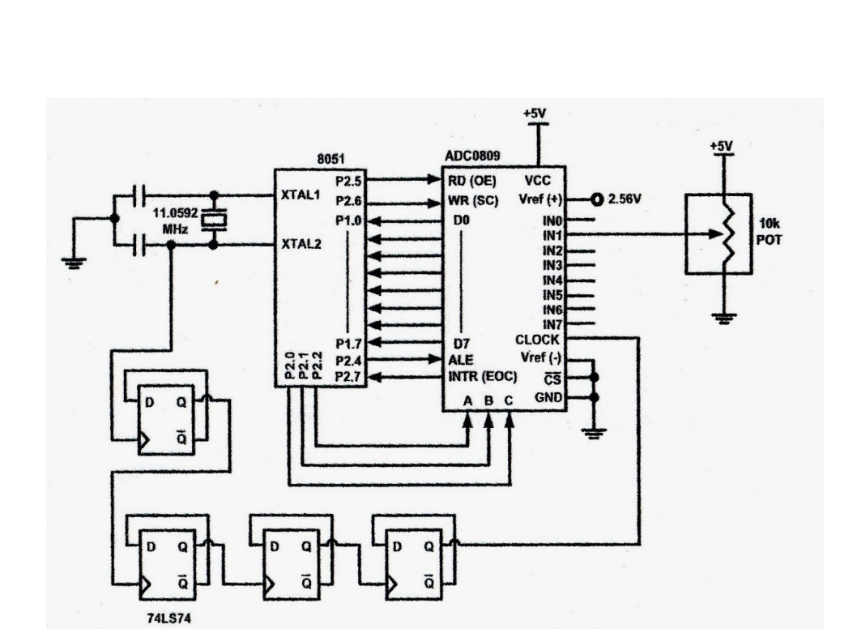
8051 Interfacing ADC

Slide 29
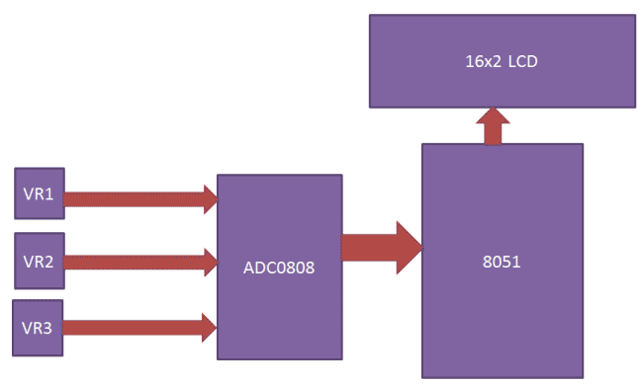

Slide 30
WORKING
Here, 3 channels of ADC0808 have been interfaced.
When you power the circuit then microcontroller initialize the LCD by using appropriate command, gives clock to ADC chip, selects ADC channel by using address line and send start conversion signal to ADC.
After this ADC first reads selected ADC channel input and gives its converted output to microcontroller.
Then microcontroller shows its value at Ch1 position in LCD.
And then microcontroller changes ADC channel by using address line.
Then ADC reads selected channel and sends output to microcontroller. And show on LCD as name Ch2. And like wise for other channels.

Slide 31
Successive Approximation ADC
Uses a n-bit DAC to compare DAC output and original analog results.
Uses Successive Approximation Register (SAR), which supplies an approximate digital code to DAC of Vin.
Comparison changes digital output to bring it closer to the input value.
Uses Closed-Loop Feedback Conversion

Slide 32
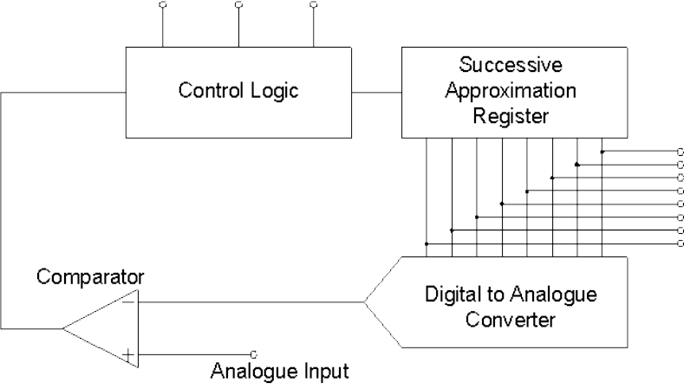
Process
MSB initialized as 1
Convert digital value to analog using DAC
Compares guess to analog input
Is V_{in}>V_{DAC}
Closed-Loop
Set bit 1
If no, bit is 0 and test next bit

Slide 33
• MSB LSB
1 0 0 0 0 0 0 0
7 6 5 4 3 2 1 0
Digital Bit | Bit Weight (V)
7 | 0.5
6 | 0.25
5 | 0.125
4 | 0.0625
3 | 0.0313
2 | 0.0157
1 | 0.0078
0 | 0.0039
If the DAC VR = 1V
DigitalValue
128
then V0 of DAC =
*V
=
=
0.5 V
2
n
R
256
• If the input is greater than 0.5V then bit set at 1 only. •
Since there is no change in output, SAR set for next trial.
MSB LSB
1 1 0 0 0 0 0 0
7 6 5 4 3 2 1 0
Now the DAC gives the output = 0.5+0.25 = 0.75V

Slide 34
• Now the comparator changes its output i.e. goes high if the input voltage is greater than 0.75V then bit 7 and bit 6 are kept as one.
If the input voltage is less than 0.75V then
1. Bit 7 is kept as 1
2. Bit 6 is kept back to 0
• Third trial
MSB LSB
1 0 1 0 0 0 0 0
7 6 5 4 3 2 1 0
Now DAC gives the output = 0.5+0.125 = 0.625
• Like this 8 trials are made.

Slide 35
• If 1 micro sec is required for 1 conversion then only 8 micro sec is required to complete the full conversion. So it is very fast.
• But converted output is valid only if the input voltage is constant during the conversion time.

Slide 36
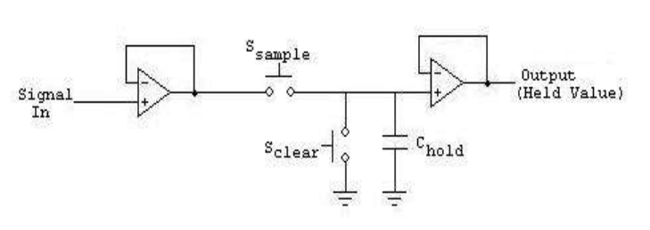
How to keep the input voltage constant ? • Latch the input voltage by using sample and hold circuit.
First Switch is connected to input voltage then after some time connect it to ground. Therefore the voltage in C remains constant.

Slide 37
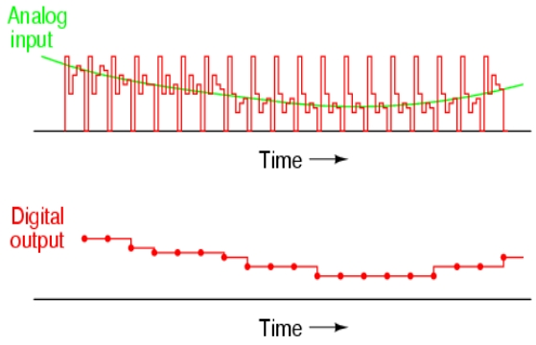
Output

Slide 38
Advantages
• Capable of high speed and reliable
• Medium accuracy compared to other ADC types
• Good tradeoff between speed and cost
• Capable of outputting the binary number in serial (one bit at a time) format
Disadvantages
• Higher resolution successive approximation ADC ’s will be slower

